Slide 1
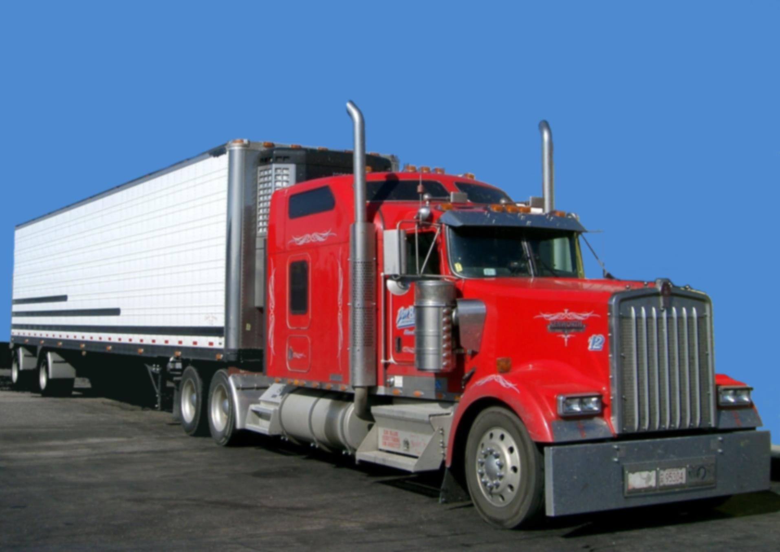
West Midlands Freight
GLOSA Trial
Andy Radford

Slide 2

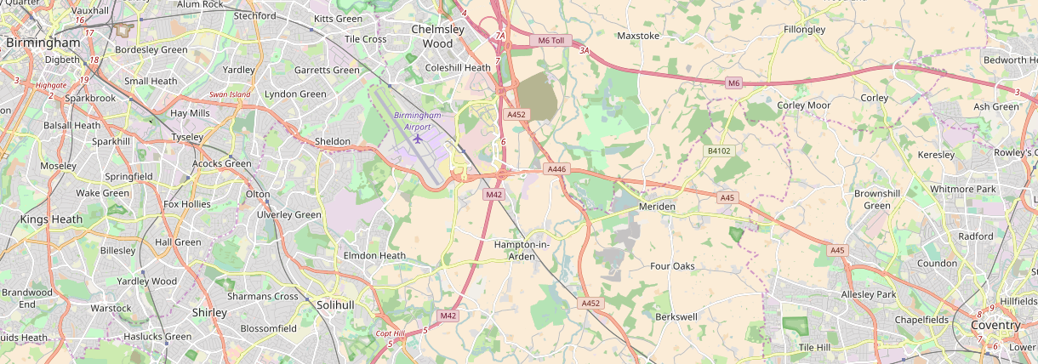
Project Definition
Berkeley Road
Forest Road
Gilbertstone Road
Lyndon Road
Wheatsheaf
Damson Parkway
Kings Road
Birmingham
Solihull
Coventry
SCOOT
MOVA
Joint SCOOT/ MOVA
Bus Priority
Greenwave
GLOSA
UK CITE
openstreetmap.org

Slide 3
Aims and Objectives
GLOSA in an adaptive control environment.
Utilising Existing Infrastructure (4G and Wifi)
Can simple changes be made to that environment that improve GLOSA accuracy
Can we demonstrate interoperability between C-ITS systems (i.e. from Birmingham to Coventry)
Can we demonstrate signal priority requests

Slide 4







WM GLOSA TRIAL
Project Data Flows
Signal information from
On street cabinets sent to
Traffic control centre either
Via direct link to controller or
SCOOT messages
Historical
Services
Prediction
Prediction provide via
4G or using existing
on-street wifi
Antennas’
FVD
Signal Requests

Slide 5
Outcomes
Safer Roads
More Reliable Journey Times
Reduced Emissions
?
Better management of network
Reduced Traffic Noise
More innovation in WM
Less Driver Frustration
Better Policy
Improved Modelling and Prediction

Slide 6
Programme
Time Period | Activity
April – June 2017 | Approvals and Procurement
July – September 2017 | Server Side Development
September – October 2017 | App Development
November – December 2017 | Testing Phase 1
December 2017 | Refine and Fix
January 2018 | Testing Phase 2
February – March 2018 | Results and Dissemination

